Slide 2
Pre-Presentation FlAixEnergy applied Loadflow with Python
Wednesday, August 22, 2018

Slide 3
Overview
Loadflow
Pandapower
Tkinter GUI
Package Distribution

Slide 4
1. Loadflow
Overview:
Newton-Raphson Method

Slide 5
Newton-Raphson Method
Nonlinear equation solving method used to solve the node voltage phasors
If the complex power can be represented by equations of complex voltages, then the NRM can be used to solve the voltage phasors
It transforms solving nonlinear equations into repeatedly solving linear equations

Slide 6
2. Pandapower
Overview:
Anaconda
Spyder
Power Flow

Slide 7
Anaconda
Anaconda:
I used the Anaconda environment to run Spyder (it also has Jupyter, VS Code, etc)
I used pip to easily install and manage packages (through Anaconda Prompt)
pip install <your module>

Slide 8
Spyder
Spyder (Python IDE):
Free, cross-platform, plugin support
Easy to install through pip
Variable Explorer
Easier to set environment and to import packages

Slide 9
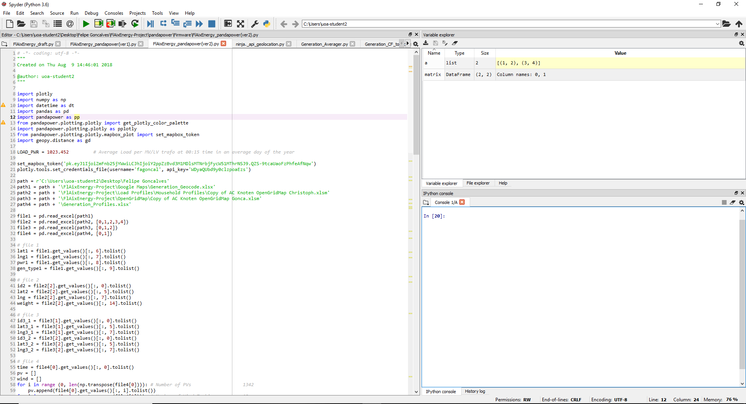
Spyder
Spyder 3.2.6

Slide 10
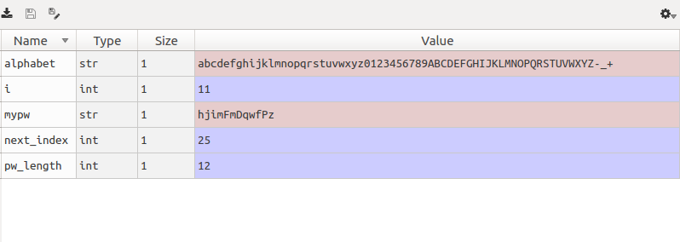
Spyder
Spyder‘s Variable Explorer

Slide 11
Power Flow
Pandapower provides an AC powerflow, DC powerflow and an OPF
Pandapower uses PYPOWER to solve powerflow problem
Set “nr” as Newton-Raphson Method

Slide 12
3. Tkinter GUI
Overview:
Environment
Code Structure

Slide 13
Environment
PyCharm (Python IDE)
Free, cross-platform, plugin support
It highlights code with PEP8 warnings → easy to read, test, maintain, and evolve the code
It helps to do refactoring (changing variable’s or template’s name)
It suggests variables, classes, etc → IntelliSense/Code Completion (great for either built-in or external packages) and Python Type Hint → good for both health and speed
Git visualization in the editor (I didn‘t use this feature though)
Package management → Nice visual representation of what‘s installed (yes, we can always use pip)
Good Debugger

Slide 14
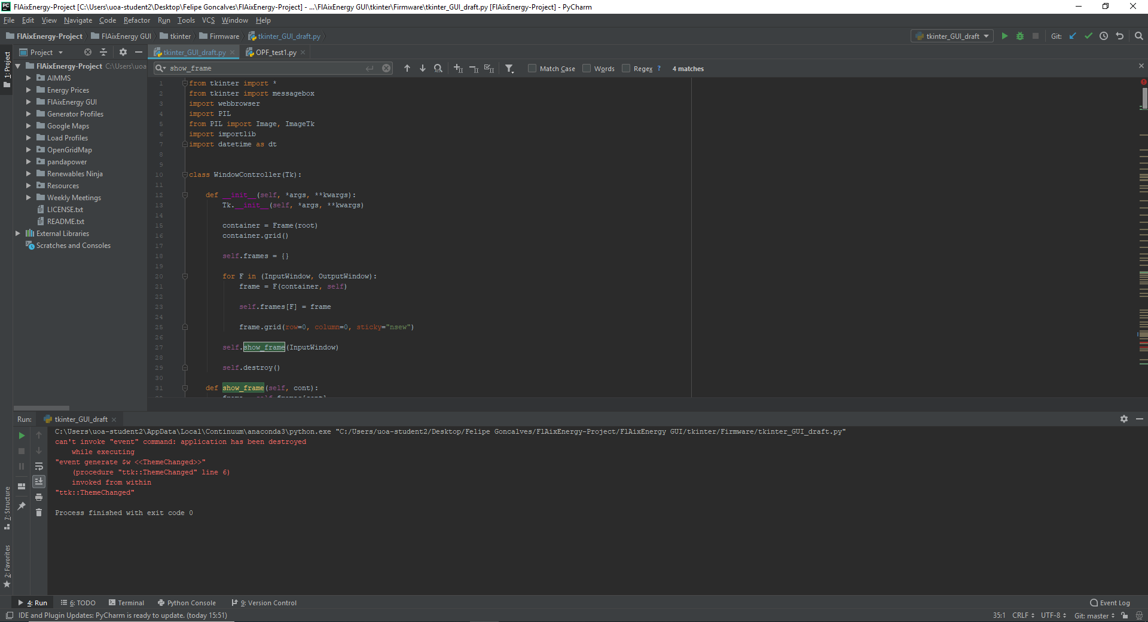
Environment
JetBrains PyCharm Community Edition 2018.1.3 x64

Slide 15
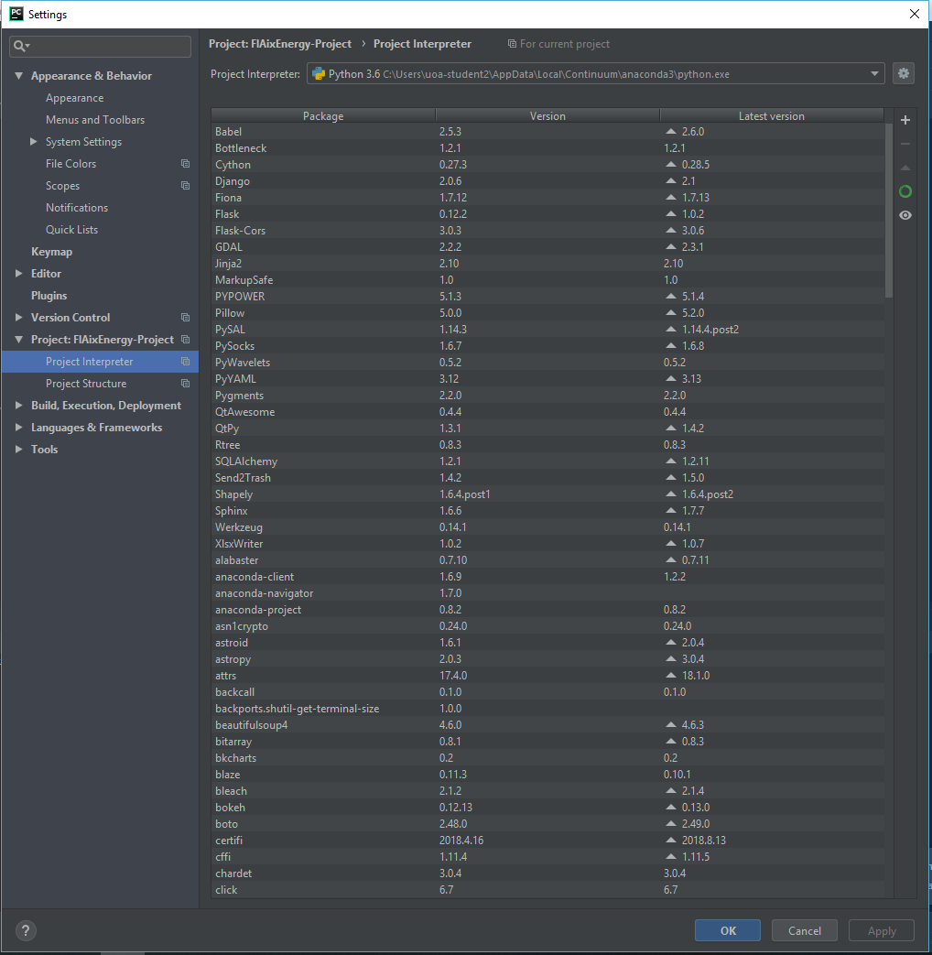
Environment
Package Management

Slide 16
Code Structure
Import packages
Define classes (Windows)
Initialize instance of a class
def __init__(self, parent, controller):
Create frame
Add widgets under grid
Define functions used in the widgets
Generate root
Initialize variables
Create main loop using classes
Structure based on https://stackoverflow.com/questions/14817210/using-buttons-in-tkinter-to-navigate-to-different-pages-of-the-application

Slide 17
Code Structure
Classes:
Window Controller
Define show_frame()
Welcome Window *
Input Window
Output Window
* can be added later

Slide 18
4. Package Distribution
Distribute Pandapower and FlAixEnergy GUI through the Python Package Index (PyPI)
Documentation on GitHub

Slide 20
Equations

Slide 21
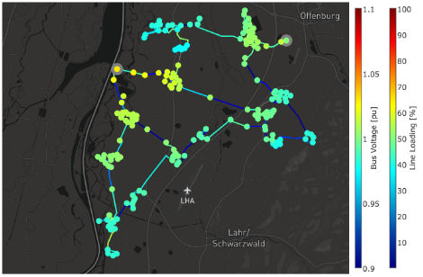
Loadflow Map

Slide 22
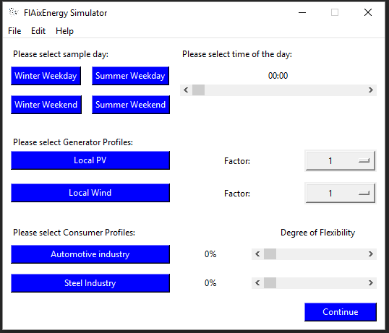
FlAixEnergy GUI

Slide 23
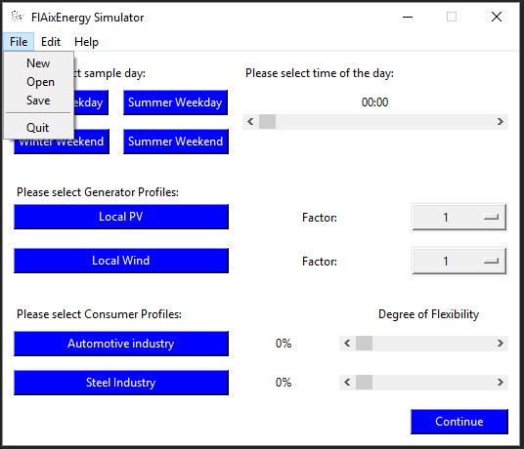
FlAixEnergy GUI

Slide 24
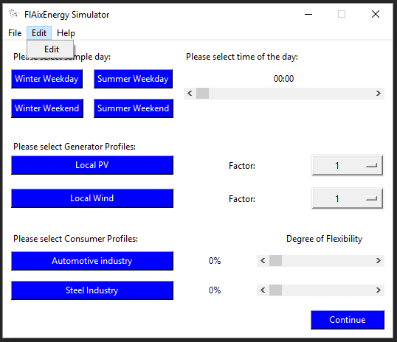
FlAixEnergy GUI

Slide 25
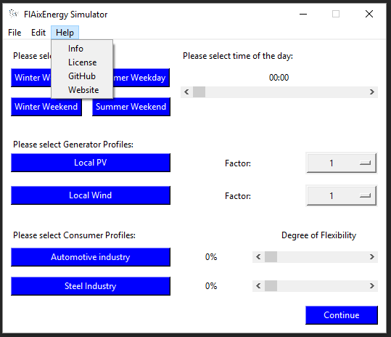
FlAixEnergy GUI

Slide 26
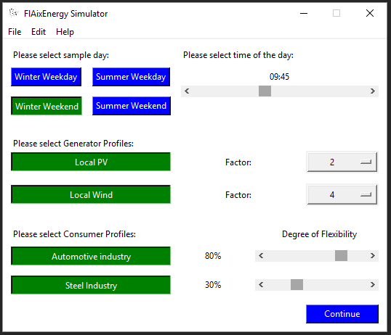
FlAixEnergy GUI

Slide 27
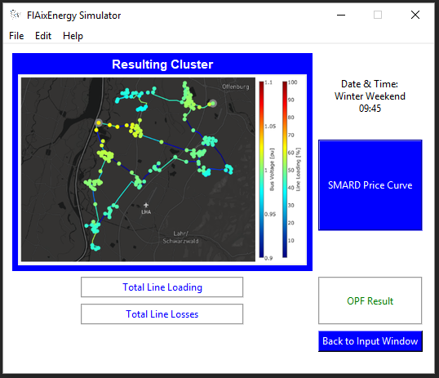
FlAixEnergy GUI

Slide 28
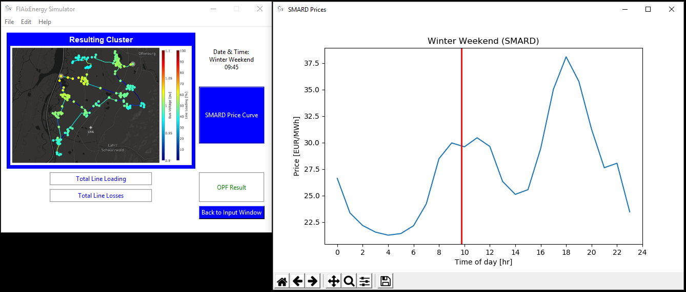
FlAixEnergy GUI

Slide 29
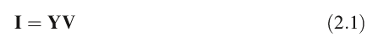
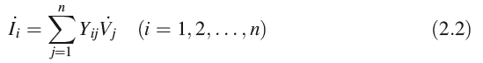
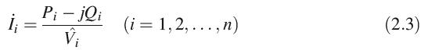
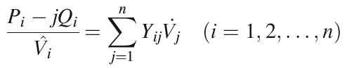
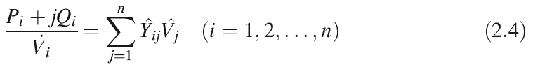
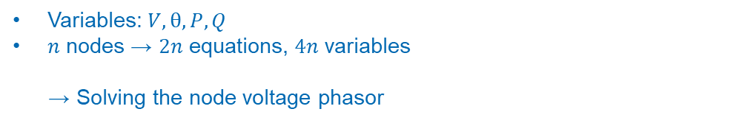
Newton-Raphson Method
Simple Power System:
or
Variables: $V, θ, P, Q$
$n$ nodes → $2n$ equations, $4n$ variables
→ Solving the node voltage phasor
X.‐F. Wang et al., Modern Power Systems Analysis. 71
doi: 10.1007/978-0-387-72853-7, # Springer Science þ Business Media, LLC 2008

Slide 30
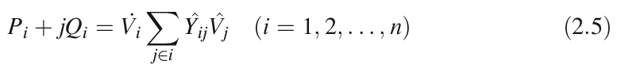
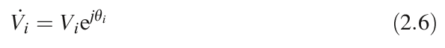
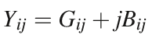
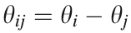
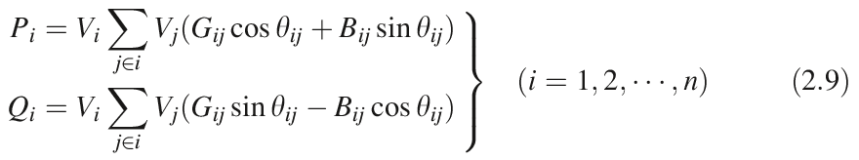
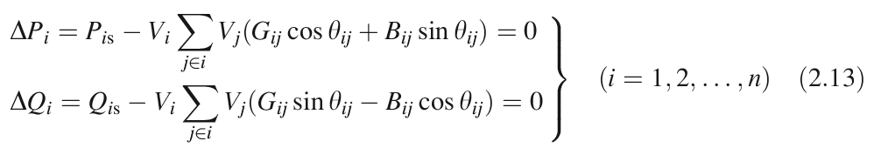
Newton-Raphson Method
(…)

